Slide 1
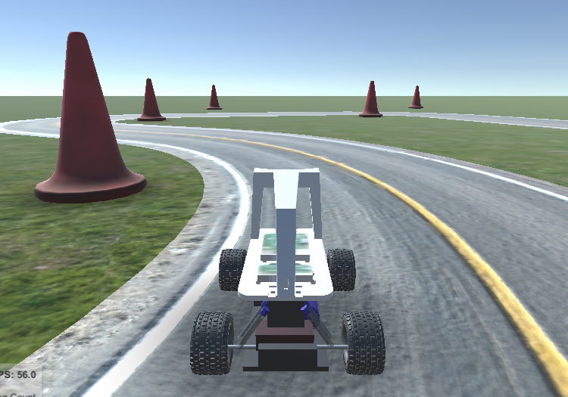
Open Project @42: « la patate » Louis Develle Luc Lenôtre Joep Barmentlo Deya Berger

Slide 2
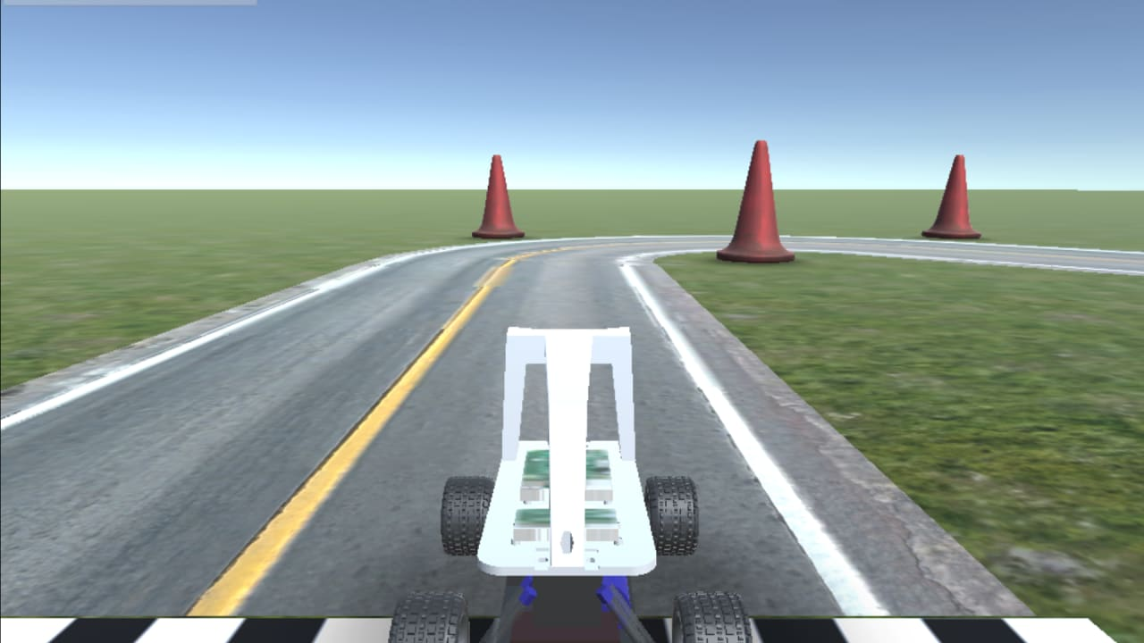
A small reminder
The goal of our project was to create and train a Deep Learning agent, capable of driving a virtual car, based on the images received by the “camera” on the top of the car.
This project had already been approached by 42AI with supervised learning, and we wanted to try something different, maybe even more challenging: Reinforcement Learning!

Slide 3
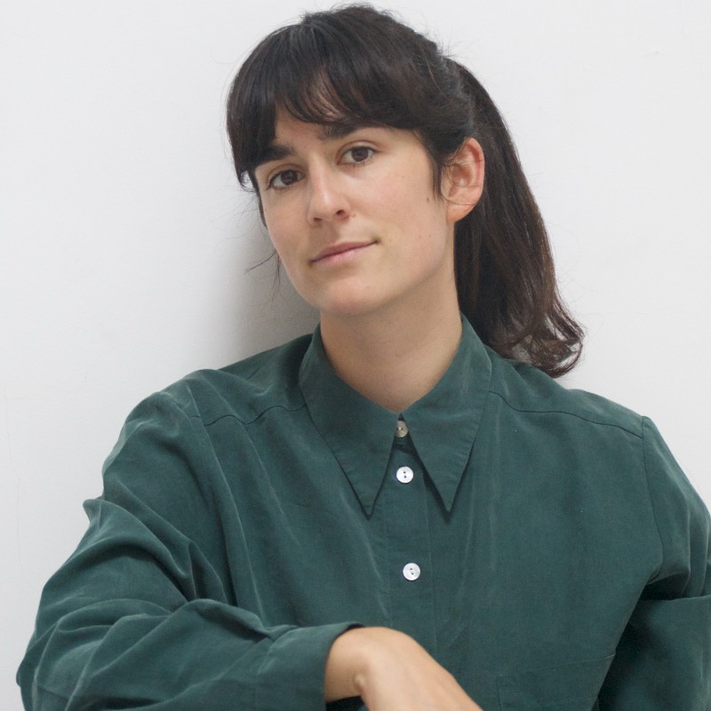
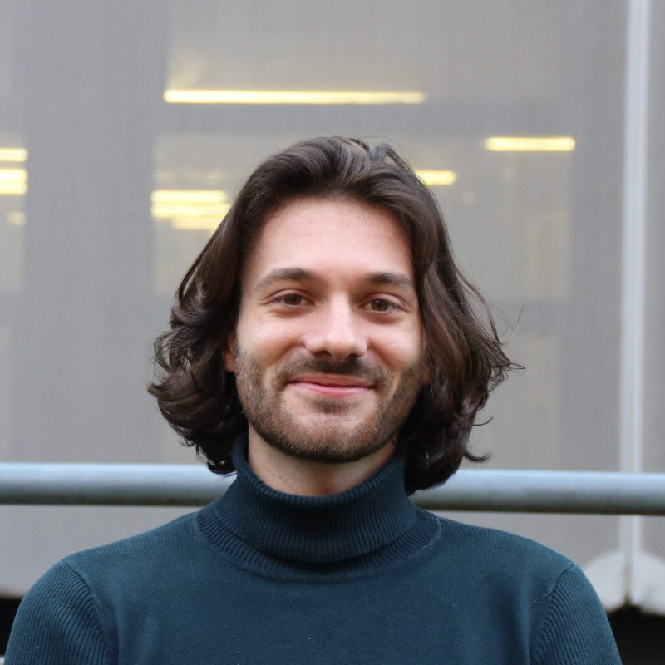
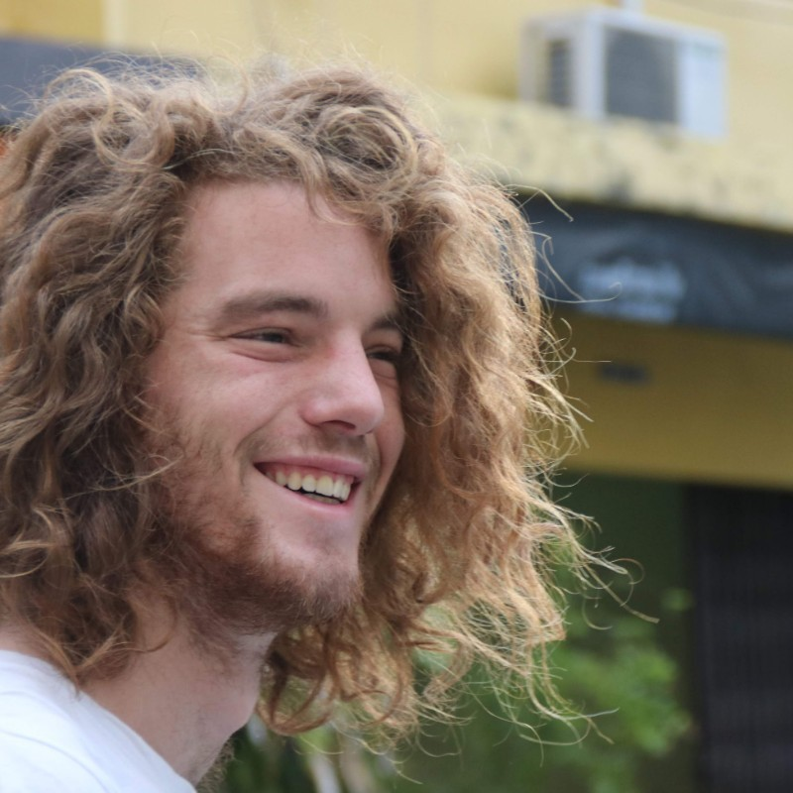
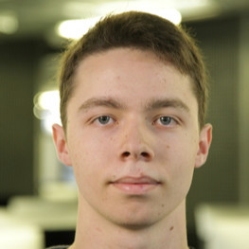
Our team:
Louis:
« El Professor »
Deya:
« The Data collector »
Joep:
« The Power master »
Luc:
« The Math Guru »

Slide 4
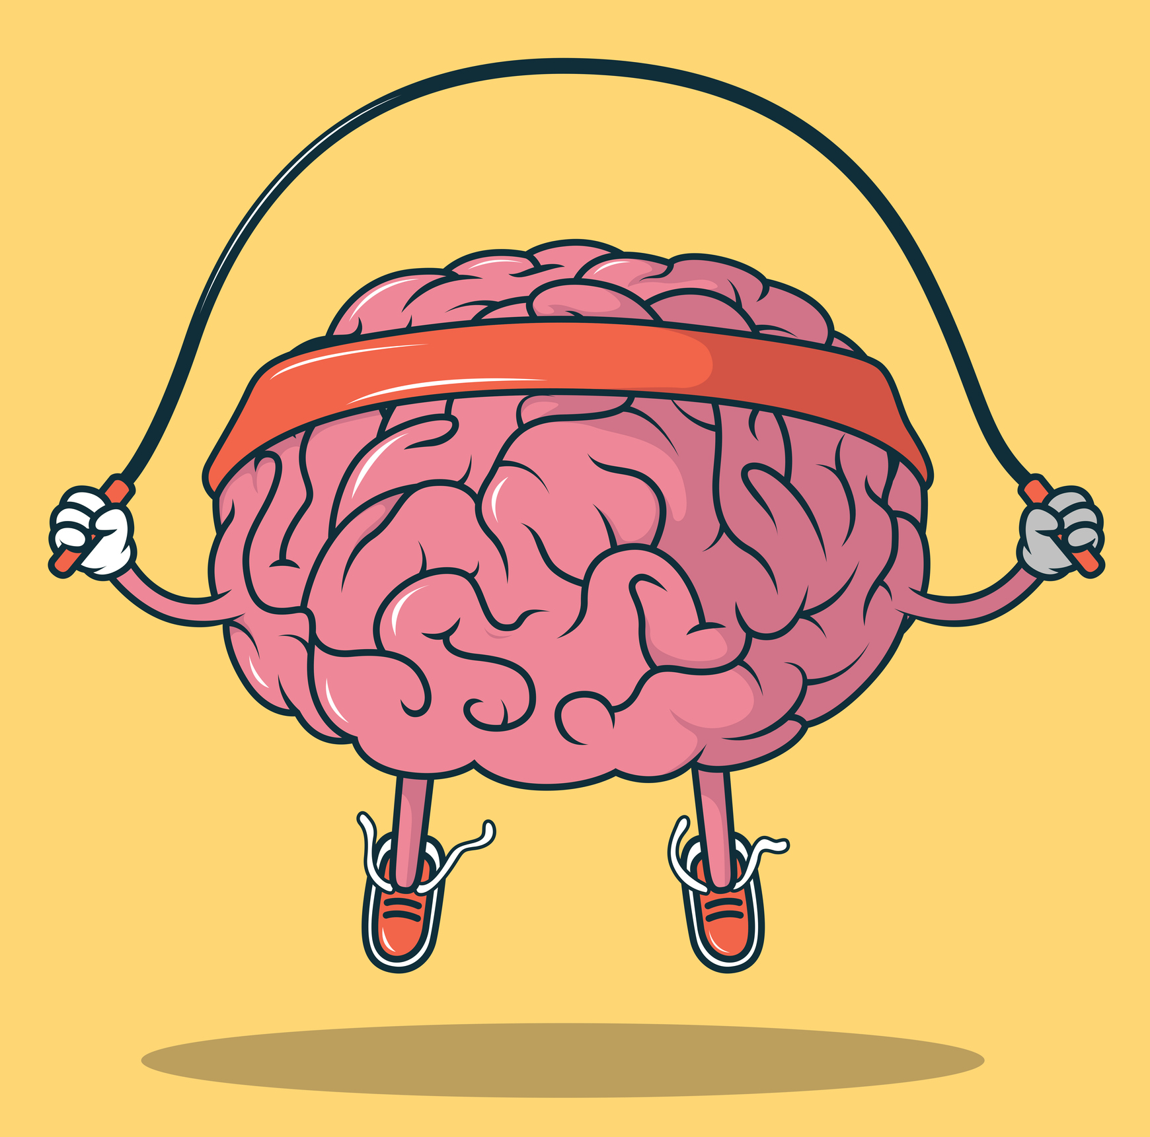
STEP 1: Define the subject
Research: state of art of reinforcement learning models
Establish the main goals
Split the work between the team members

Slide 5

STEP 2: Get into dirt
Interface Configuration
Model creation
Data storage
Performance evaluation
Optimization
… Oh and… participate to the race

Slide 6
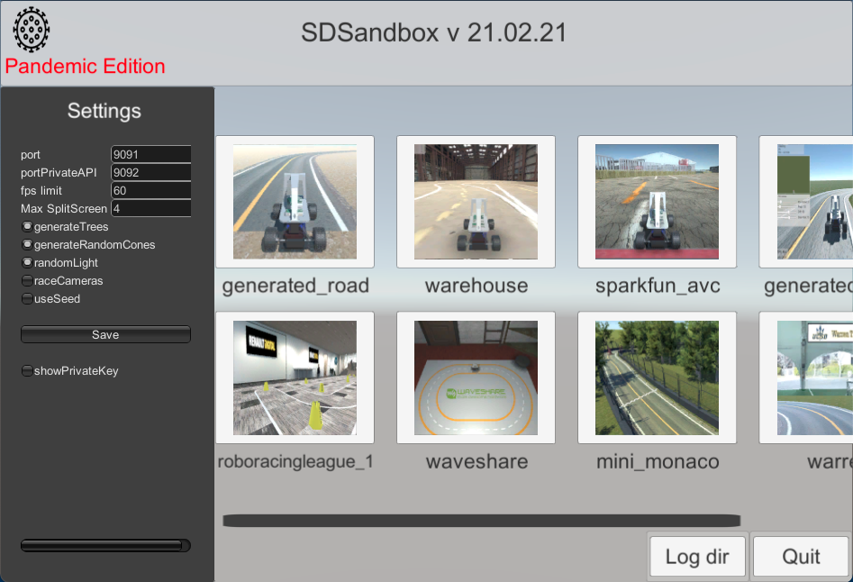
1-THE INTERFACE
What we are working with:
A racing simulator (Donkeycar interface)
A Server to launch and close a simulator on a certain port
Our main program that communicates with the simulator and our server.
A Dockerfile to manage all the environment specificities
}

Slide 7
1-THE INTERFACE
Information we receive from this simulator:
Images from a camera on the top of the car
Information about velocity, position, acceleration etc… that won’t be available for the real competition.
}

Slide 8

2-THE MODELS
Double Deep Q learning (DDQN)
Soft Actor Critic (SAC)

Slide 9


2a-DOUBLE DEEP Q LEARNING
This algorithm was developed by enhancing a classic RL algorithm called Q-Learning with deep neural networks and a technique called experience replay.

Slide 10
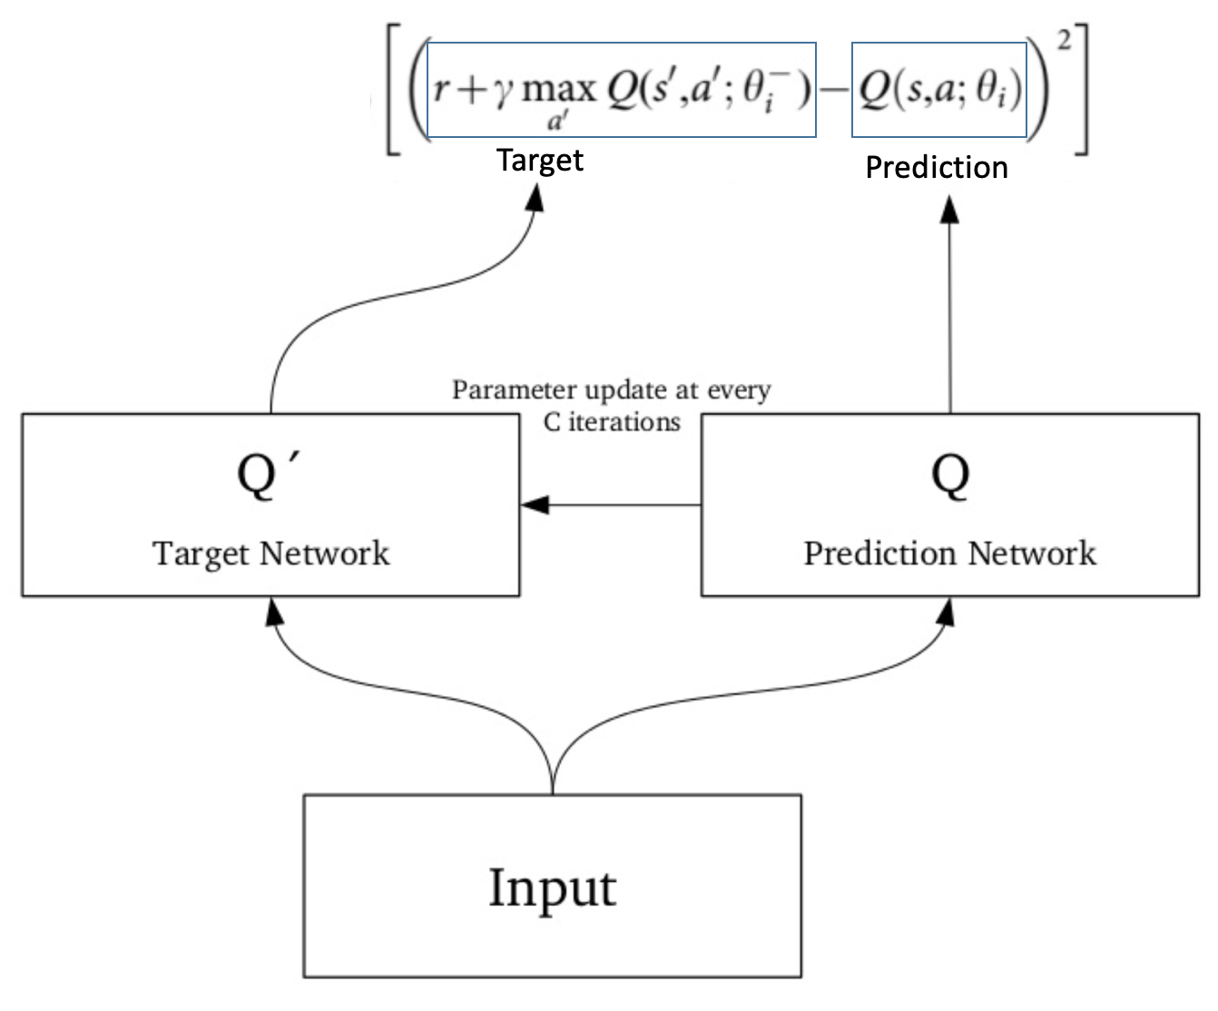
2a-DOUBLE DEEP Q LEARNING
Q-Learning is based on the notion of a Q-function.
The Q-function of a policy π, Qπ(s,a), measures the expected return or discounted sum of rewards obtained from state ’s’ by taking action ’a’ first and following policy ’π’ thereafter.

Slide 11

2b-SOFT ACTOR CRITIC
Soft Actor-Critic(SAC) is one of the states of the art reinforcement learning algorithm developed jointly by UC Berkeley and Google.
Instead of only seeking to maximize the lifetime rewards, SAC seeks to also maximize the entropy of the policy. (entropy = how unpredictable a random variable is)

Slide 12
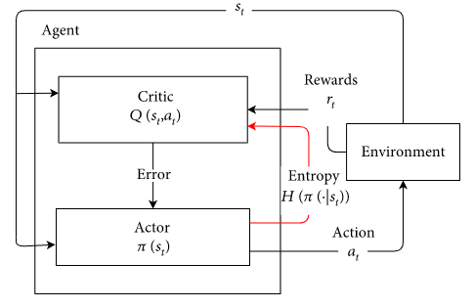
2b-SOFT ACTOR CRITIC

Slide 13

3-DATA STORAGE
We used an AWS S3 bucket to store the following files:
Simulator cache to train the Autoencoder and DDQN with it
DDQN, SAC and Autoencoder Model weights
Configurations files
Performance data

Slide 14
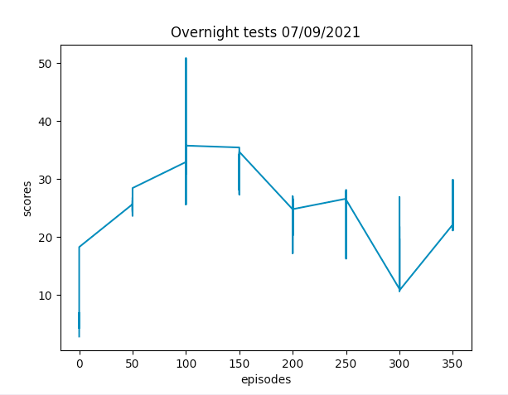
4-PERFORMANCE EVALUATION
A scoring with a mix of data: speed, close to center, distance from start, number of iterations by episodes before dying, epsilon etc…
It helped us change the parameters to try increase the performance

Slide 15

5-OPTIMIZATION

Slide 16
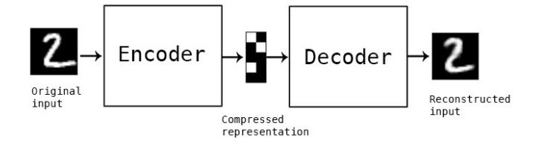
5a-PREPROCESSING: AUTOENCODER
Autoencoder is an unsupervised artificial neural network that learns how to efficiently compress and encode data then learns how to reconstruct the data back from the reduced encoded representation to a representation that is as close to the original input as possible.

Slide 17

5b-BAYESIAN OPTIMIZATION
It is an approach that uses Bayes Theorem to optimizing objective functions that take a long time (minutes or hours) to evaluate.
In our project we used it to find parameters for our training that would maximise our performance.

Slide 18
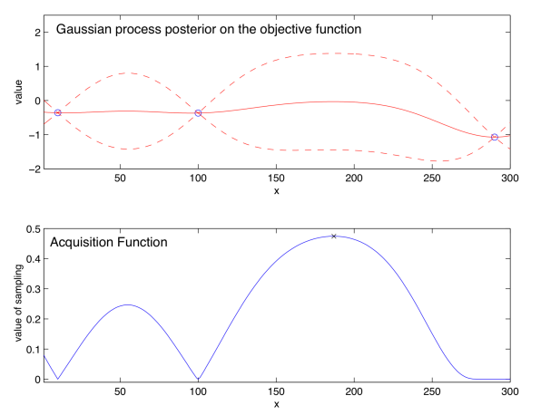

Slide 19
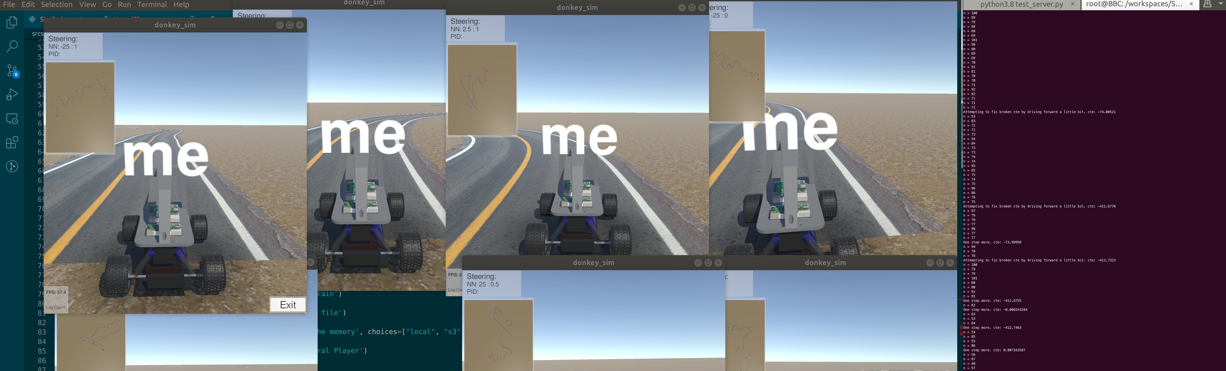
5c-DISTRIBUTED LEARNING
Distributed deep learning is one such method that enables data scientists to massively increase their productivity by running parallel experiments over many devices (GPUs/TPUs/servers) and massively reducing training time by distributing the training of a single network over many devices

Slide 20

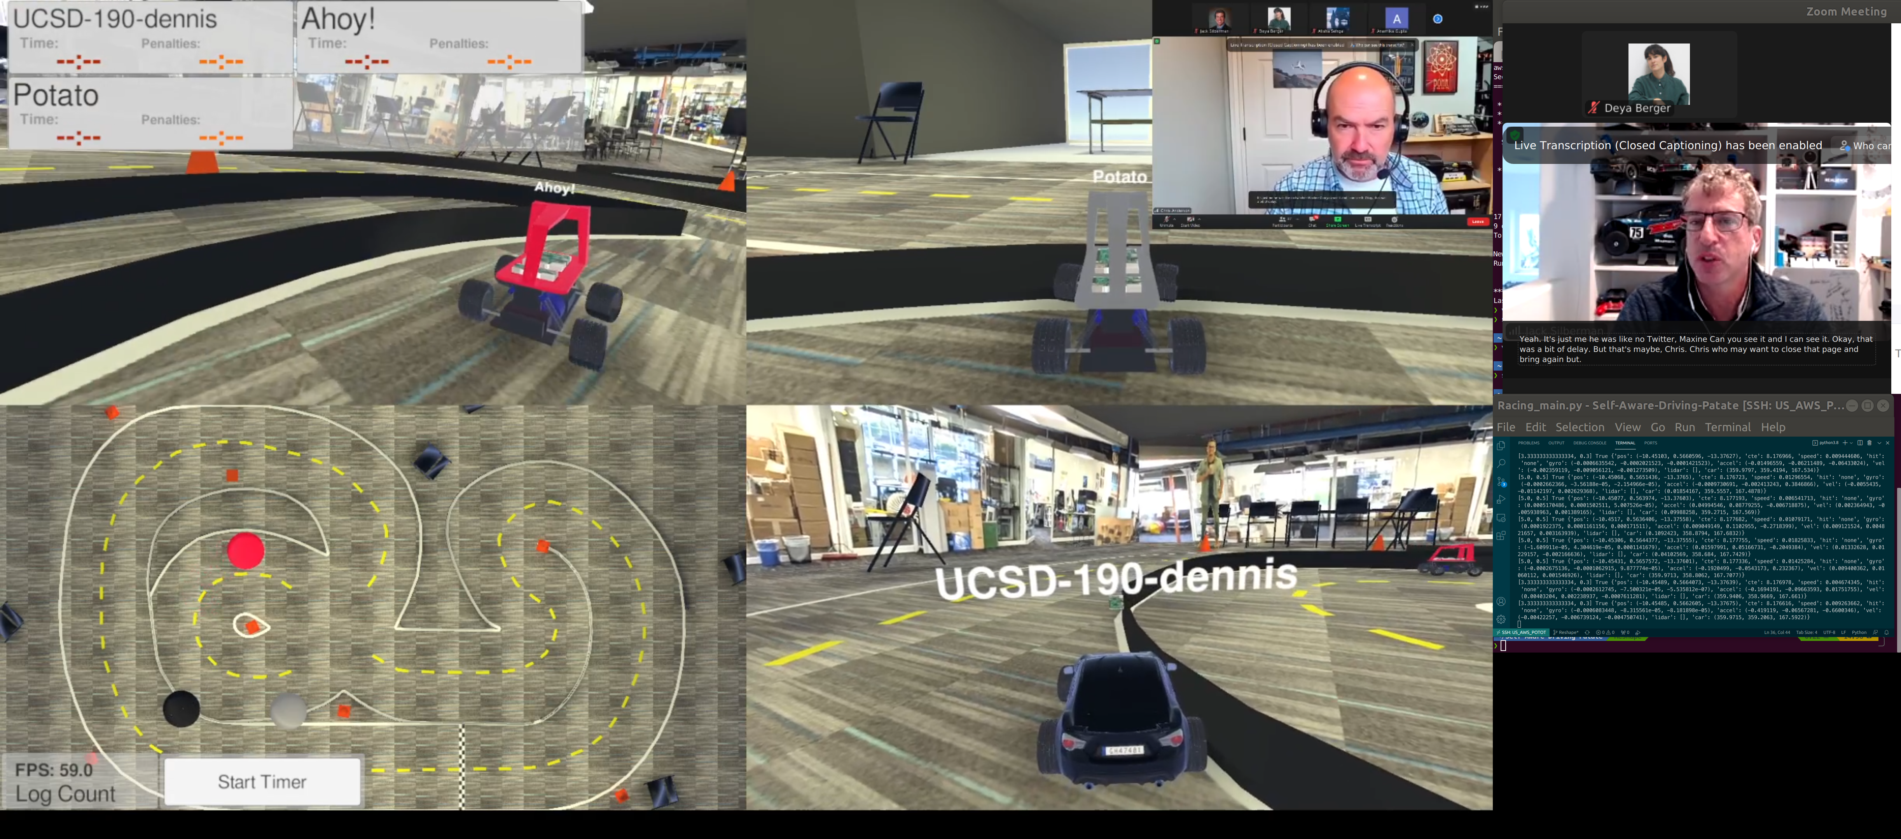
5-PARTICIPATION TO THE RACE

Slide 21

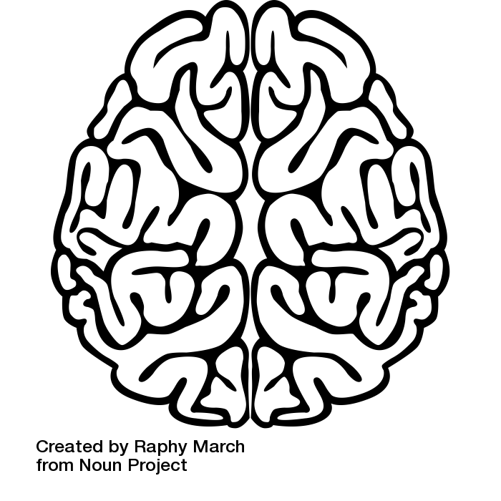


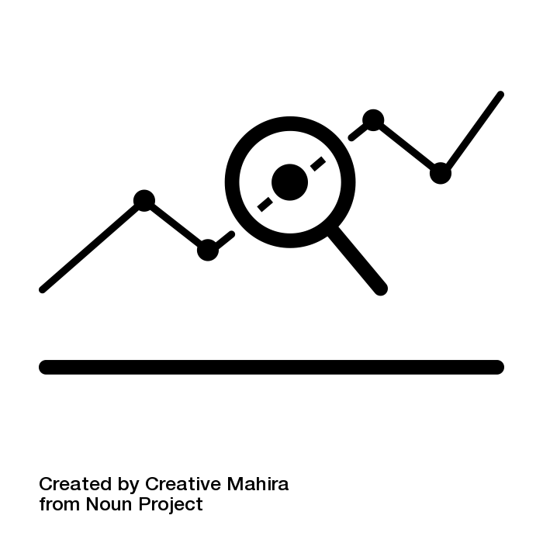
What this project taught us:
Never loose focus on the global target:
Taking a step back on our daily tasks as a team to check if we are going in the right direction
New knowledge in diverse fields (Deep learning, data science & engineering)
Organisational skills: weekly meetings, keeping up with our Trello, assigning tasks with precise deadlines
Getting better at estimating the time and difficulty of a task, and knowing when to move on
Notes:
Slide ou l’on parle de ce qu’on a appris mais aussi de nos difficultés et comment on les a surmonté etc

Slide 22

Have we met our initial goals?
1. DonkeyCar Interface
2. Looking for sponsors
3.Quality metrics
4. State of the art for RL models
5. Data Engineering
6. Model Creation
7. Optimization
8. Race
9. And more….

Slide 23
Any Questions?

